Slide 1
SHOPEE Project Proposal
Jyoshika Barathimogan | Rishika Bimal Attodi

Slide 2
Table of contents
01
02
03
04
05
06
PROBLEM DEFINITION
Our research
Product specification
Design mock-ups
prototype
Business case model

Slide 3
01
PROBLEM DEFINITION

Slide 4
PROBLEM DEFINITION
As Shopee Mall is an integral part of our business and to Shopee users, we are
always committed to powering the next phase of growth for local brands and retailers,
and uplifting the Shopee Mall experience. In light of the increasing need to provide a
streamlined and engaging online shopping experience for our users, propose an
innovative solution(s) to attract more
users to Shopee Mall.

Slide 5
02
Our research

Slide 6
SOLUTION 1: Leader board point system
Split the customer based on region, such as Singapore, Malaysia and more.
Point system for top 5 active member per region for writing top and relevant reviews can have 5 point awarded.
Point system for top 30 shoppers for making most purchase can have 15 points awarded.
Point will be tabulated per month.
Top 10 people with most point will have high discount rate or nice offers while other top 40 loyal customer can have their usernames displayed in leader board too without prize.
Top 10 will get the offers via email at the end of each month.

Slide 7

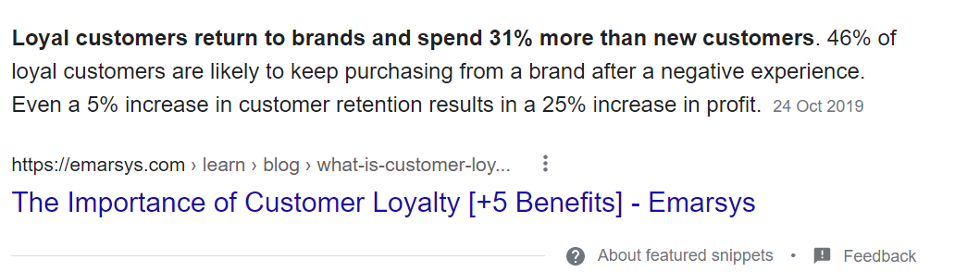
Discounts and offers are indeed a key to customer’s heart. However, we need to acknowledge those who fits the recency, frequency and monetary value of any data analytics. Those who fits the RFM are known as repeat customers (loyal)
Encouraging the most active and loyal customers is what this solution is all about. As this will boost company’s profit, the statistical evidence is shown in figure 1 below, indicating benefits.
A loyal customer is considered more significant that a satisfied one. There are more emphasis in attracting new customers, but a via loyal customers, the chances of losing them due to any circumstances will be lower and can be a brand advocate for the new customers as well, which means marketing can be done by them too, saving cost from customer acquisition. Do check out the links in speaker notes to support this point.
Solution 1: Leaderboard system
WHY?
Figure 1
Notes:
https://portalcfo.com/why-customer-loyalty-is-more-important-than-customer-acquisition/
https://emarsys.com/learn/blog/what-is-customer-loyalty-and-why-is-it-important/#:~:text=Loyal%20customers%20return%20to%20brands,a%2025%25%20increase%20in%20profit

Slide 8
Solution 1: Inspiration
The inspiration is from two sources.
- HPB fitness tracker (National Steps Challenge™)
- Subway surfs game leader board system
HPB fitness tracker, keeps track of the number of steps a person has walker or the time taken by the person to exercise, the more the steps are or the higher the duration taken respectively, they leader board will be updated accordingly. Just like this, for Shopee scenario we can use data analytics to capture those who make most purchases, actively write reviews to be captured in leader board as they win attractive prizes.

Slide 9
SOLUTION 2: walkthrough game
Walkthrough storyline where users can play and select in the game itself and directly add to cart to purchase. many genres will be selected such as thriller, horror, crime, romance, fantasy and more.
Interesting interactive storyline with 2 to 3 endings depending on the choice users make. if users purchase items, they can be led to an exclusive ending. one choice can be default where user don’t need to purchase the item while the other two items can be where users will be displayed with multiple Shopee items, and if they like it on the spot, they can choose it.
The products can be from any categories, including groceries, outfits and more. this is just a brief-through description, prototype will give an in-depth view of this idea. after the whole game, which can contain many episodes, they can have 5-dollar e-voucher if they get the best endings. one story can only be played once, to prevent money loss for company. also, one ending is only obtained to those who make in-game purchase while 2nd ending is offered for best ending with discount prize while 3rd ending will lead to nothing.

Slide 10
Solution 2: walkthrough game
Interactivity is something users would love. The idea is a marketing strategy, where users can find out more about the product while having fun. Attracts those who love stories and games. Sometimes, users can pounce upon items they do not know about or though of purchasing while being in the game. They might be interested in those products and might be compelled to buy more, moreover they would be interested to get an exclusive ending for the story!
WHY?

Slide 11
Solution 2: Inspiration
Episode choose your story game which has over 100M downloads. I have seen how people would make in-app purchases as well as spend several diamonds(which is a point system for choices to get cool endings). This idea inspired me to have a shopee’s version but with a little twist.

Slide 12

SOLUTION 3: NAVIGIATION BAR
Idea
Navigation bar at the top left-hand corner. Exactly below the Shopee logo on desktop view.
While for mobile view, swipe right will bring out the list of categories

Slide 13
Navigation bar
it is noticeable that Shopee does not have a navigation bar unlike it competitor Lazada.
Hence having a clearly defined navigating bar will allow customer to effortless go through the process of viewing and purchasing product.
Moreover with clear and concise categories it will allow customer to rapidly and easily access information about the products available.
With strategic positioning of navbar, creates a very clean and uncluttered appearance.
Overall, it will defiantly improve customer experience with the application, and this will attract new customers and higher purchase rates.

Slide 14
SOLUTION 4: Dark mode
Idea
Dark Mode for Shopee for both mobile and desktop application.
This will directly tie in with mobile feature.
User can choose their preferred mode by changing in the settings for both desktop and mobile.

Slide 15
Dark Mode
Having dark mode make sit easier to stay focus and reduce eye strain at night.
Moreover, the contents do stand out while darkened controls recedes into the background.
It is very benefitable when comes to purchasing products during mid-night sales and customer will be more comfortable to shop with dark mode on.
With this design functionally has proven popular with many users, Shopee can use leverage on the use of dark mode to attract more customers

Slide 16
03
Product specification
Notes:
Leaderboard system… sidebar for categories

Slide 17
Product Summary: solution 1
By using shopee database, we will gather customer details such as the region they are from, name, also gather amount spend under payment details and filter the people who constantly have more likes for their feedbacks that were considered relevant. Then we will use necessary code since shopee use MYSQL and TiDB, to retrieve the top customers and display them in a scoreboard while separating top spenders and reviewers into two sections with a filter system for regions too. A great example of this layout is in the subway surfers game leader board.

Slide 18
Product Summary: solution 2
Photoshop and illustrator used for characters. With animations for character movements and interactions. Followed by options just like one we see in MCQ. In three options, two of them are for purchasing items and the last would be default. There are many interactive game software's we can use with programming such as c#, html, CSS and js. Most importantly getting new storylines to regularly update new stories to entice readers.

Slide 19
Product Summary: solution 3
A navigation bar for all the categories for Shopee placed under the Shopee logo for desktop view.
It contains all the categories grouped, hence displays it is a more categorical way for the customer to easily navigate.
For the mobile application, when the customer swipe right, it opens up a vertical list of category. User can choose their category and it is automatically brings them back to the home page with their resulted filtered.

Slide 20
Product Summary: solution 4
To enable the dark mode, users first have to navigate to the “Me” page, where there will be a setting icon on the top right hand corner. When directed to “Account Setting” page, under setting, there will be a new feature called “Display”. There will be option for the user to choose their mode.
If dark mode is enabled on user mobile, Shopee application will automatically enable dark mode with a pop-up saying “Shopee have enabled dark mode”

Slide 21
04
Business case model

Slide 22
Solution 1 : Leaderboard
Advantages
resources
Encourage Loyal customers to continue using shopee as they promote it to newer customers. New customers will also be motivated to enter leaderboard due to attractive prices, which makes them spend more and be more active.
New code have to be added into the application to show which links to the database
disadvantage
benefits
Implementation can be a concern even if it is feasible but need to know how to link with database. Whether the prices offered are attractive to the customers.
Retain old customers and also attract more customer participation

Slide 23
Solution 2 : Walkthrough game
Advantages
benefits
More customer interactivity. Able to recommend and market products like groceries which is quite hard to promote.
Will attract people, new form of marketing, people can enjoy as they view product, increasing the chances of buying. It’s a fresh and unique idea that is not present in other competitors.
disadvantage
benefits
Takes an extremely long time to implement, requires a large team, budget concerns can arise.
New code and software needs to integrated
Notes:
New code and software needs to integrated

Slide 24
Solution 3 : NAVBAR
Advantages
resources
Customer can easily navigate through the various number of products. Also customer can see a variety of option that might expend their purchase
New code have to be added into the application to show the navbar.
disadvantage
benefits
If it is not arranged properly, it might over crowd the website. Or the font is to small for the customer to read. This can be avoided by proper designing
Having a positive customer experience, more people will be inclined to use and purchase products from Shopee

Slide 25
Solution 4: dark mode
Advantages
disadvantage
Since, it reduces eye strain and increases focus, customer can spend more time browsing, hence increasing the chances of high purchases.
A lot of time and resources are needed to successful launch dark mode in both mobile and desktop.
resources
Dark mode images brightness and contract should be reduced and implement dark mode typography. Moreover, the use of dark mode icons is needed. Overall, a lot more coding is needed to launch dark mode for both mobile and desktop.
benefits
Having a positive customer experience, more people will be inclined to use and purchase products from Shopee

Slide 26
05
Design mock-ups

Slide 27
Leaderboard

Slide 28








LEADER BOARD
Singapore
LOYAL LEADERS
Can filter all regions, with “all” being default.
Each region per two sections “Loyal Leaders” and “Active Leaders” can have 50 winners. If someone were to attain both, they can get the “Supreme Leader” title. Loyal leaders is for those who spend a lot. While active leaders are those who have well-liked reviews. The leader board will be updated every month
1.
1500
Melvin Tan Xin
Kelsey123
1000
2.
MaiaXxX
950
3.
Click to view 47 more
ACTIVE LEADERS
1.
1000
Cassie
Aaron.g
950
2.

Slide 29
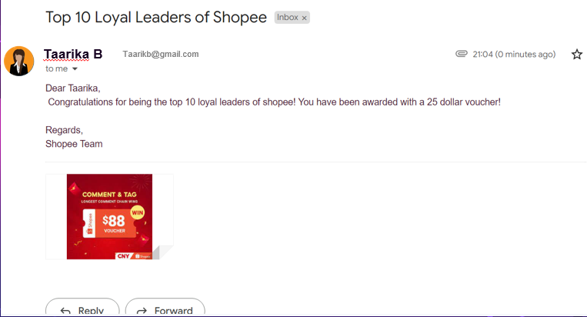
Top winners will get an email from Shopee. The prize will be given into their account

Slide 30
Walkthrough game

Slide 31
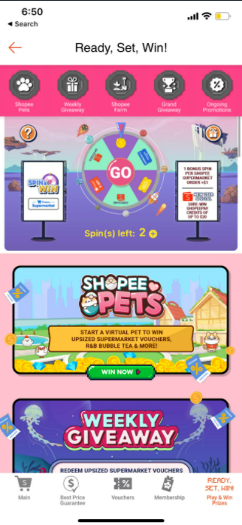

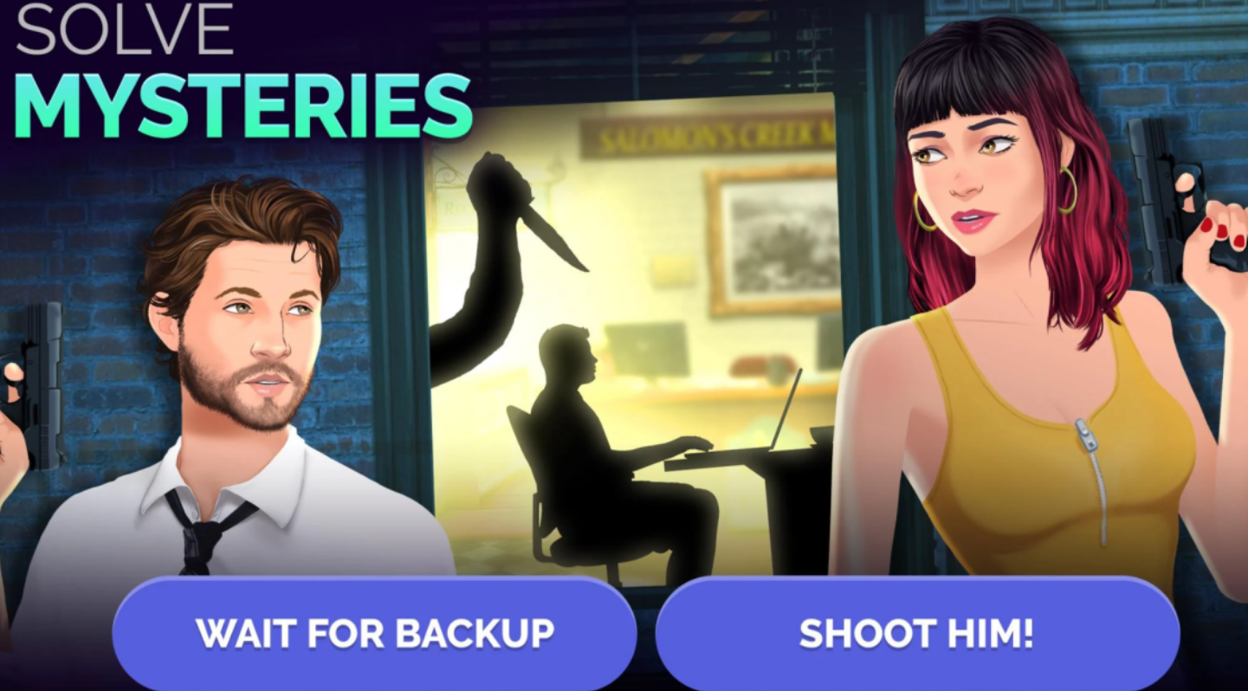
SHOPEE
STORIES
SELECT THE GENRES YOU LOVE. READ NOW, GET THE ENDING FOR THE OFFER, MAKE BOLD CHOICES TO GET EXCLUSIVE ENDING!
START NOW
Notes:
https://portalcfo.com/why-customer-loyalty-is-more-important-than-customer-acquisition/
https://emarsys.com/learn/blog/what-is-customer-loyalty-and-why-is-it-important/#:~:text=Loyal%20customers%20return%20to%20brands,a%2025%25%20increase%20in%20profit

Slide 32



SHOPEESTORIES
Genre
Notes:
https://portalcfo.com/why-customer-loyalty-is-more-important-than-customer-acquisition/
https://emarsys.com/learn/blog/what-is-customer-loyalty-and-why-is-it-important/#:~:text=Loyal%20customers%20return%20to%20brands,a%2025%25%20increase%20in%20profit

Slide 33
NAVBAR

Slide 34
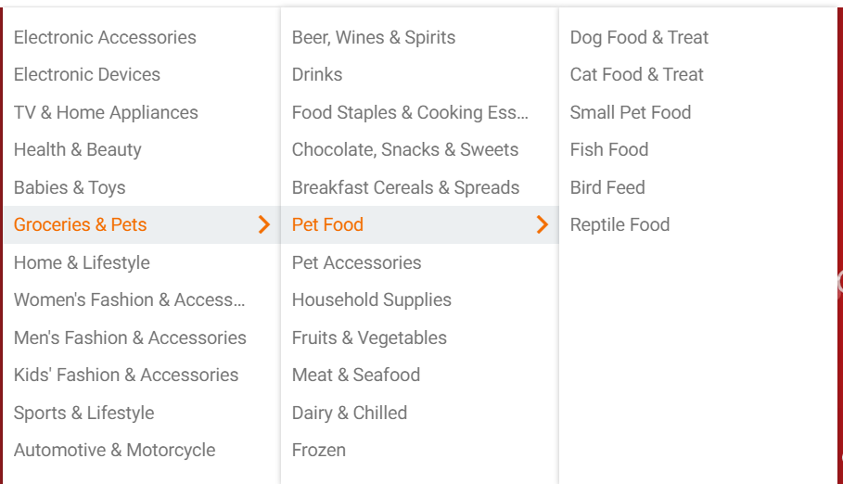
Design mock-up: solution 3 - DESKTOP
A navigation bar for all the categories for Shopee placed under the Shopee logo for desktop view.
It contains all the categories grouped, hence displays it is a more categorical way for the customer to easily navigate.
Notes:
https://portalcfo.com/why-customer-loyalty-is-more-important-than-customer-acquisition/
https://emarsys.com/learn/blog/what-is-customer-loyalty-and-why-is-it-important/#:~:text=Loyal%20customers%20return%20to%20brands,a%2025%25%20increase%20in%20profit

Slide 35
Design mock-up : solution 3 - MOBILE
After launching the App, the user can swipe right, hence it shows the user will all the categories. Moreover when user click a main category it then shows the sub-category.
When user chooses a sub-category, it redirected them to the page with the products filtered for them.
Notes:
https://portalcfo.com/why-customer-loyalty-is-more-important-than-customer-acquisition/
https://emarsys.com/learn/blog/what-is-customer-loyalty-and-why-is-it-important/#:~:text=Loyal%20customers%20return%20to%20brands,a%2025%25%20increase%20in%20profit

Slide 36
darkmode

Slide 37
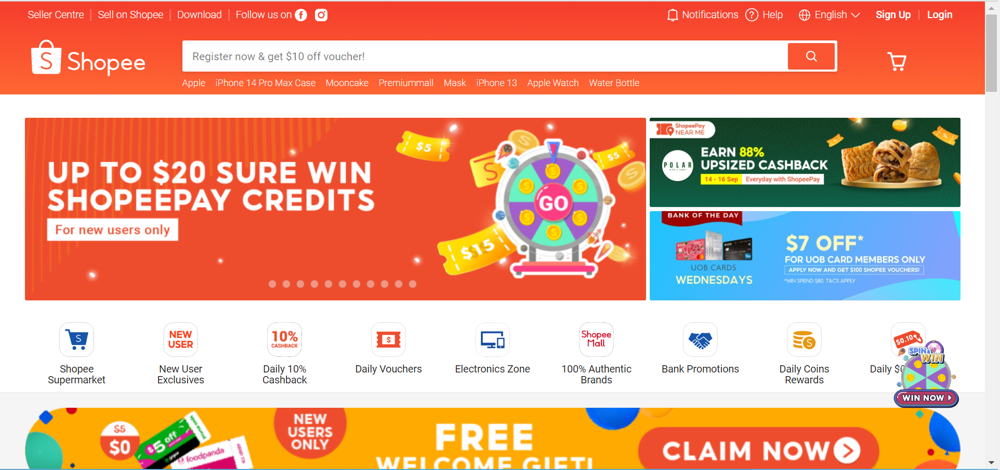
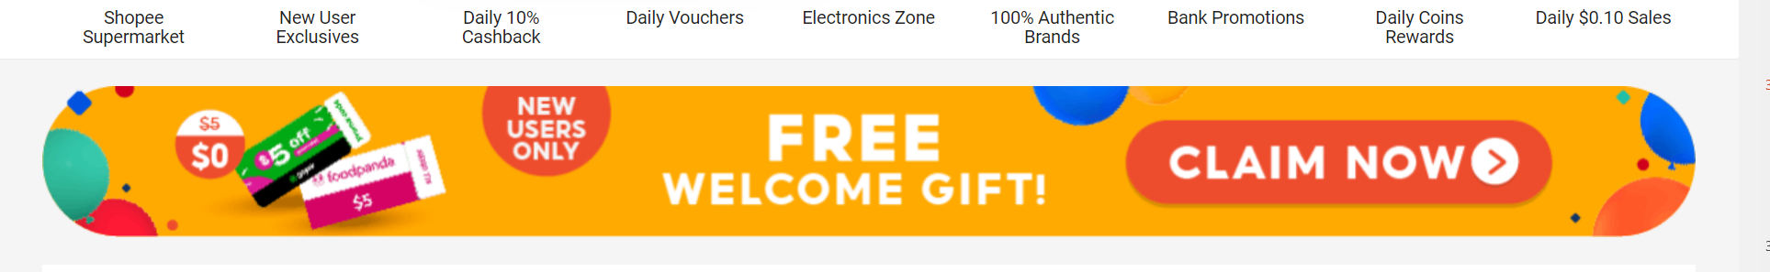
Design mock-up: solution 4 - DESKTOP
Dark mode enabled for desktop
Notes:
https://portalcfo.com/why-customer-loyalty-is-more-important-than-customer-acquisition/
https://emarsys.com/learn/blog/what-is-customer-loyalty-and-why-is-it-important/#:~:text=Loyal%20customers%20return%20to%20brands,a%2025%25%20increase%20in%20profit

Slide 38
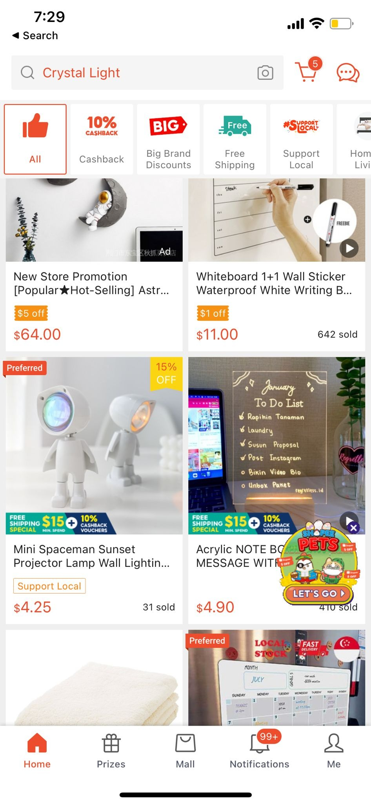
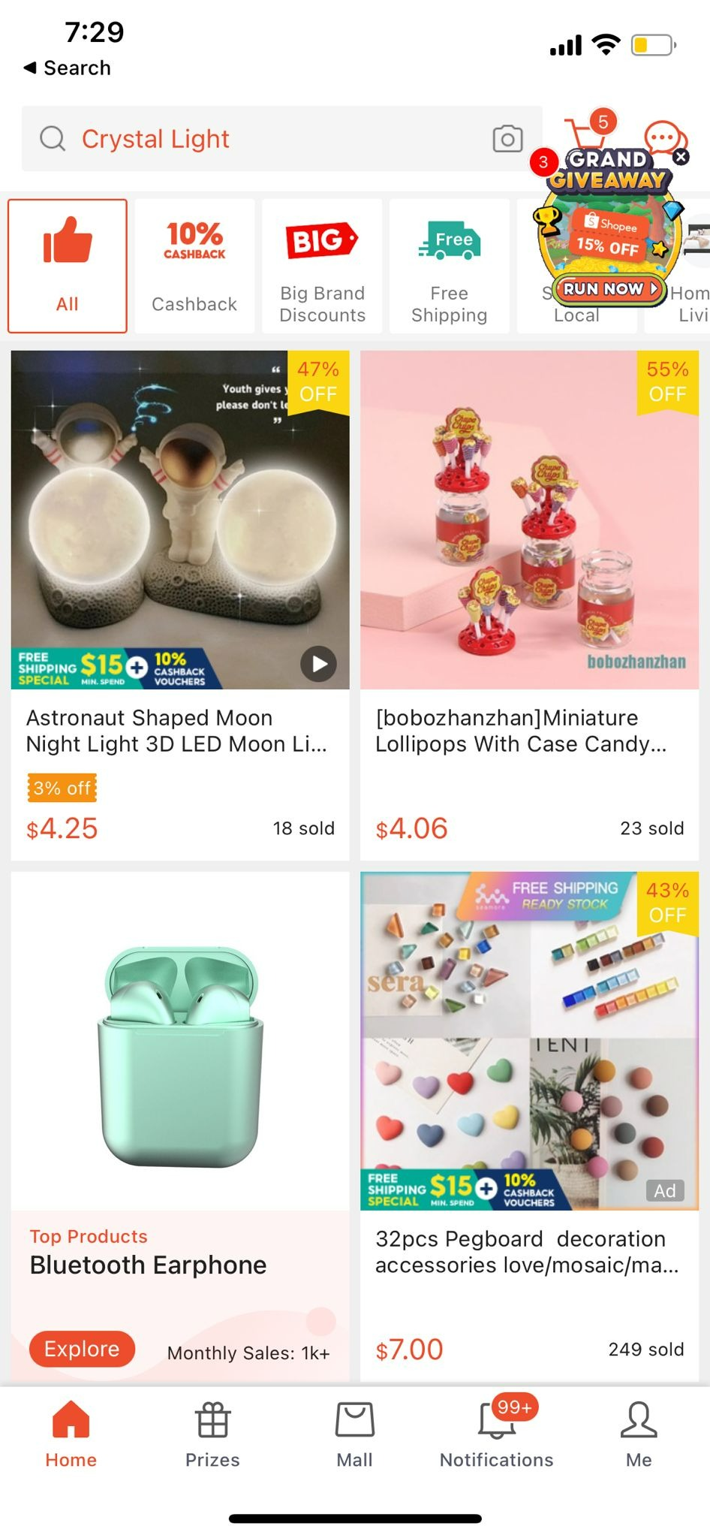
Design mock-up: solution 4 - MOBILE
Dark mode enabled for mobile
Notes:
https://portalcfo.com/why-customer-loyalty-is-more-important-than-customer-acquisition/
https://emarsys.com/learn/blog/what-is-customer-loyalty-and-why-is-it-important/#:~:text=Loyal%20customers%20return%20to%20brands,a%2025%25%20increase%20in%20profit

Slide 39
06
prototype

Slide 40
LEADERBOARD
SOULTION 1

Slide 41









LEADER BOARD
LEADER BOARD
LEADER BOARD
LEADER BOARD
Taarika
Taarika
Taarika
Taarika
Singapore
ALL
ALL
Singapore
Malaysia
LOYAL LEADERS
LOYAL LEADERS
LOYAL LEADERS
LOYAL LEADERS
Thailand
Singapore
1500
2500
2500
1.
1500
Melvin Tan Xin
1.
1.
Nur Alysha
Nur Alysha
1.
Melvin Tan Xin
Vietnam
1000
2000
2000
Kelsey123
1000
2.
Kinderjoy
Kinderjoy
2.
2.
Kelsey123
2.
950
1500
1500
MaiaXxX
950
3.
Melvin Tan Xin
Melvin Tan Xin
3.
3.
MaiaXxX
3.
Click to view ALL
Click to view ALL
Click to view 47 more
4.
950
Skylus
Tricky Trisha
950
5.
ACTIVE LEADERS
ACTIVE LEADERS
ACTIVE LEADERS
6.
900
Taarika
1500
1500
1.
1000
1.
Arianne
Arianne
1.
Cassie
Aaron.g
900
7.
1000
1000
Joker
950
Joker
2.
2.
Aaron.g
2.
900
PosionIvy.
8.

Slide 42
Walkthrough game
SOULTION 2

Slide 43


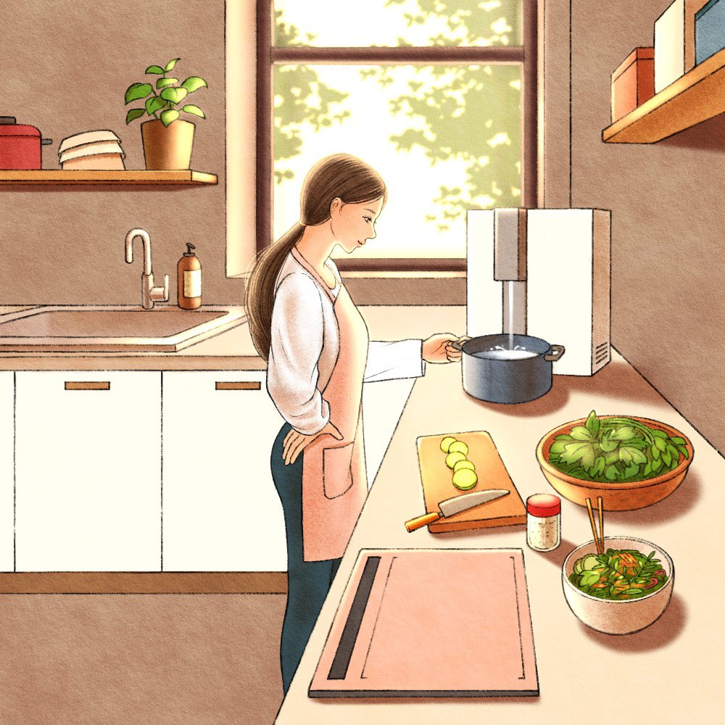
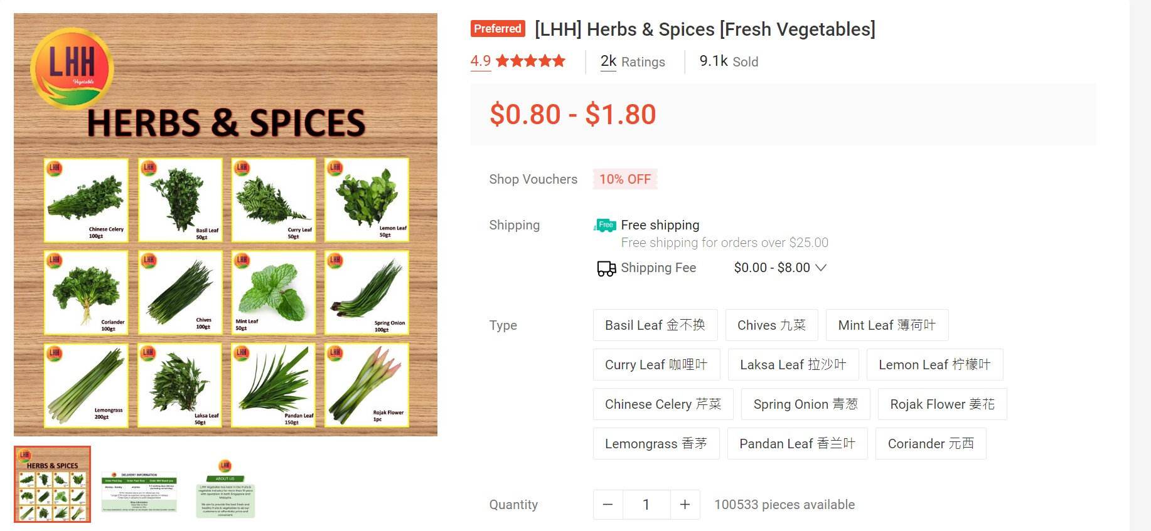
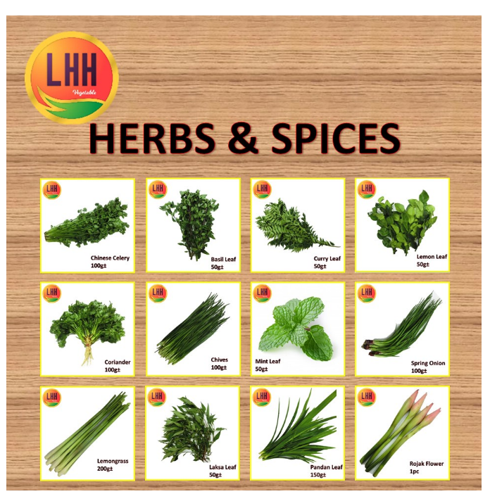
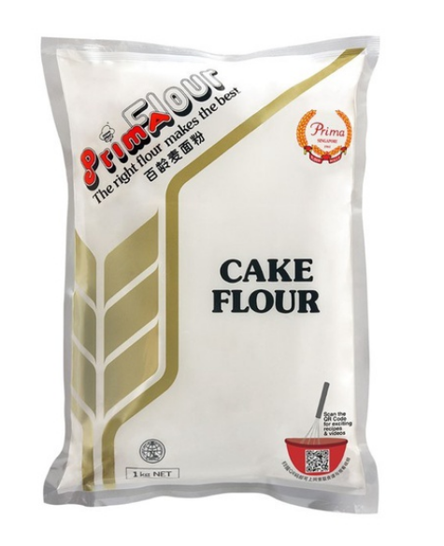
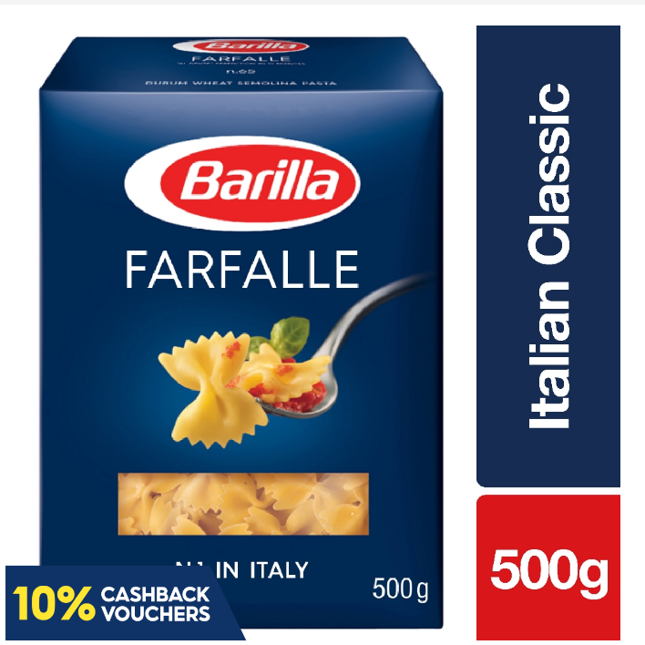



Drama
SHOPEESTORIES
Christmas is coming in 4 days! I don’t have most ingredients for the dishes, when they are coming and most stalls are closed or hectic or out of stoke…
X
Genre
SHOPEE
STORIES
Choose a food:
SELECT THE GENRES YOU LOVE. READ NOW, GET THE ENDING FOR THE OFFER, MAKE BOLD CHOICES TO GET EXCLUSIVE ENDING!
Order ingredients
Cook with whatever I have
Drama Queen
That One Teacher
My Pathetic Life
View
For cake
View
For Pasta
View
Go out and eat
Add to cart
X
Back
START NOW

Slide 44
NAVBAR
SOULTION 3

Slide 45
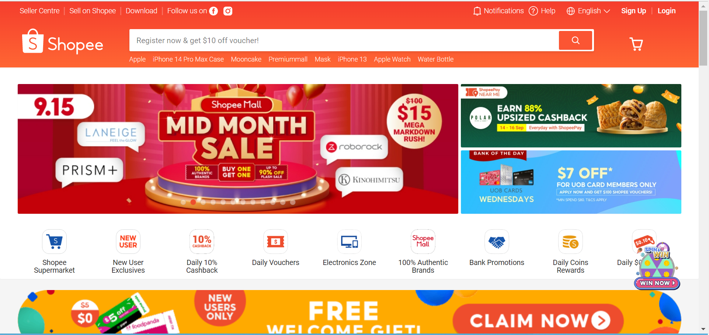
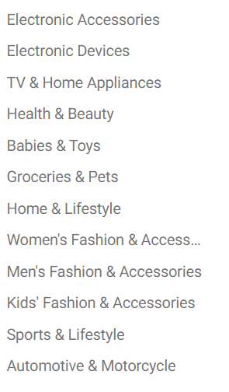
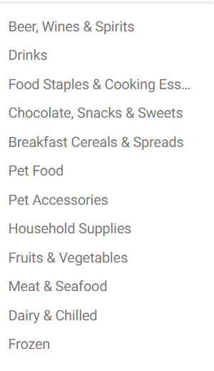
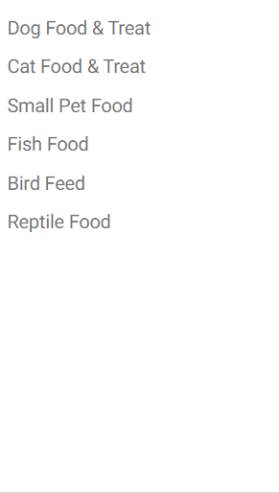
Desktop navbar
Please play the slide for the animated prototype
Notes:
https://portalcfo.com/why-customer-loyalty-is-more-important-than-customer-acquisition/
https://emarsys.com/learn/blog/what-is-customer-loyalty-and-why-is-it-important/#:~:text=Loyal%20customers%20return%20to%20brands,a%2025%25%20increase%20in%20profit

Slide 46
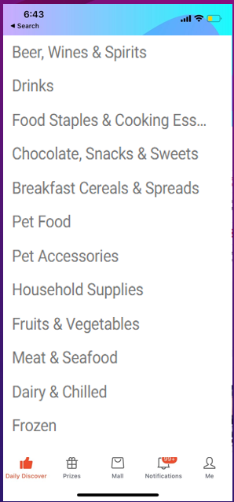
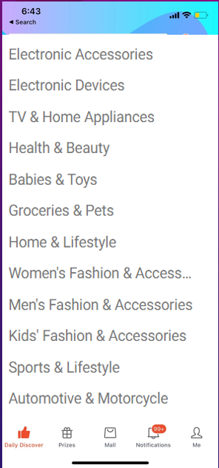
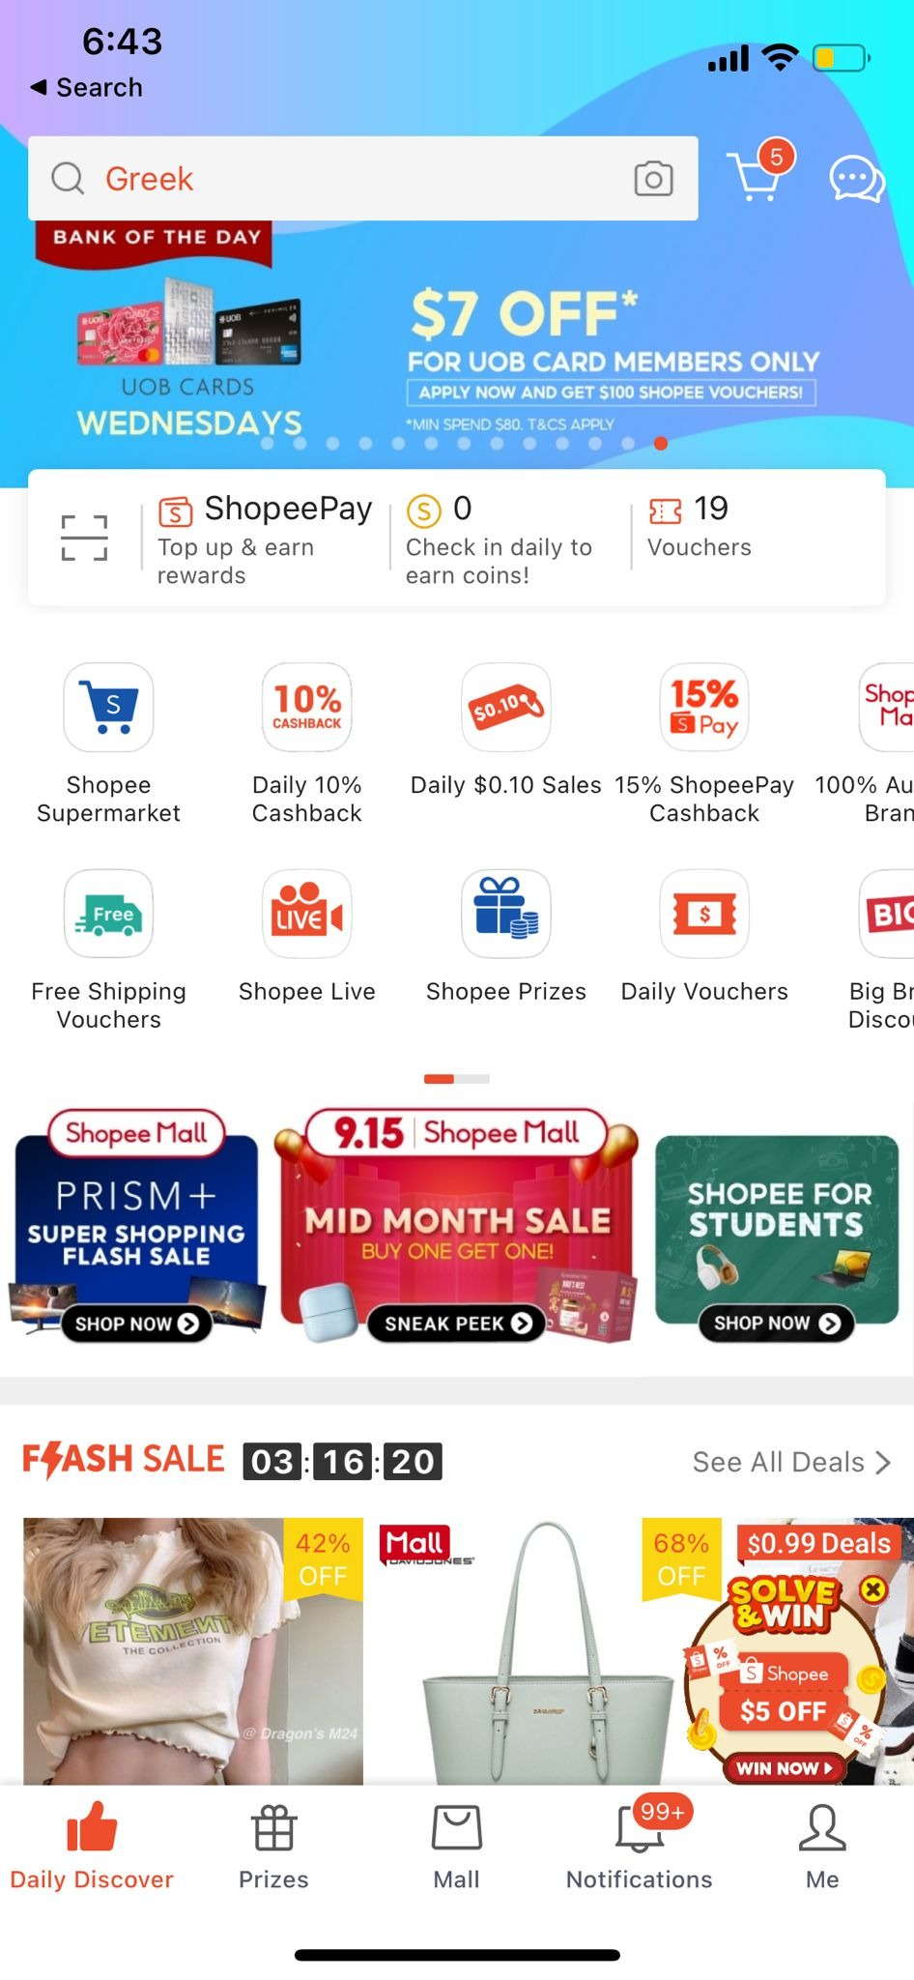
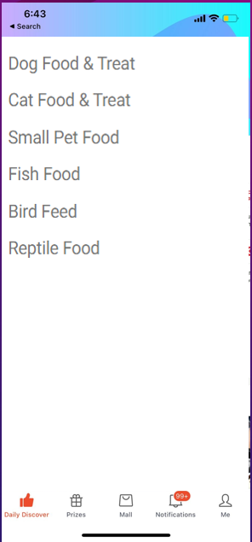
APP navbar
Please play the slide for the animated prototype
Notes:
https://portalcfo.com/why-customer-loyalty-is-more-important-than-customer-acquisition/
https://emarsys.com/learn/blog/what-is-customer-loyalty-and-why-is-it-important/#:~:text=Loyal%20customers%20return%20to%20brands,a%2025%25%20increase%20in%20profit

Slide 47
DARKMODE
SOULTION 4

Slide 48
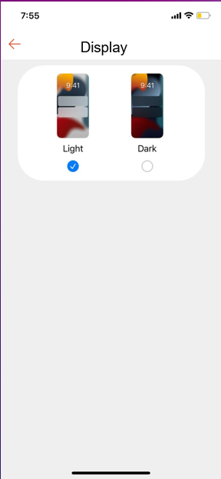
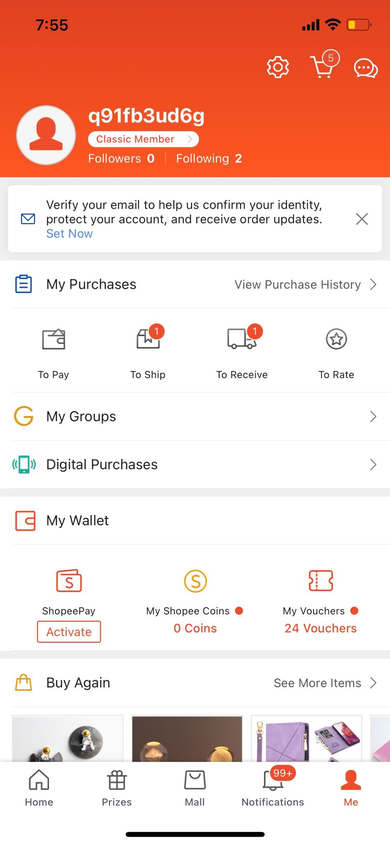
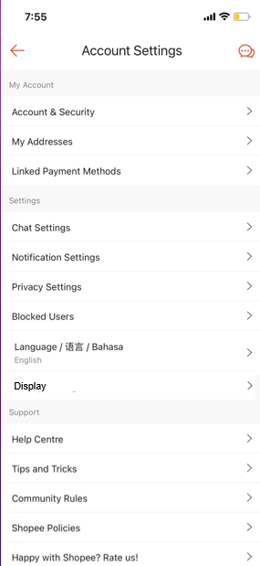
dark mode MOBILE PROTOTYPE
Please play the slide for the animated prototype

Slide 49
Link to animation of prototype
https://youtu.be/G6geanYjryY

Slide 50
Thank you!
Please keep this slide for attribution

